Slide 1
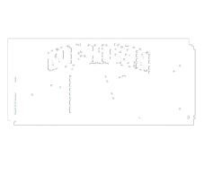
PRICE DETERMINATION IN MARKETS
The market demand curve shows the amount demanded at every price.
The market supply curve shows the amount supplied at every price.
The question now is whether there is some price at which the quantities supplied and demanded are the same.

Slide 2
EQUILIBRIUM PRICE DEFINED
The equilibrium price of a good is:
  a price at which quantity supplied equals quantity demanded.
  a price at which excess demand equals zero.
At the equilibrium price there is no net tendency for price to change.

Slide 3
Excess demand exists when, at the current price, the quantity demanded is greater than quantity supplied.
Excess supply exists when, at the current price, the quantity supplied is greater than the quantity demanded.

Slide 4
Excess supply = Q_{s} - Q_{D}
price
EXCESS SUPPLY
supply
p = $3
demand
Q_{D}
Q_{S}
quantity
Market for tacos

Slide 5
Excess demand = Q_{D} - Q_{S}
price
supply
EXCESS DEMAND
p = $1
demand
Q_{S}
Q_{D}
quantity
Market for tacos

